Slide 1

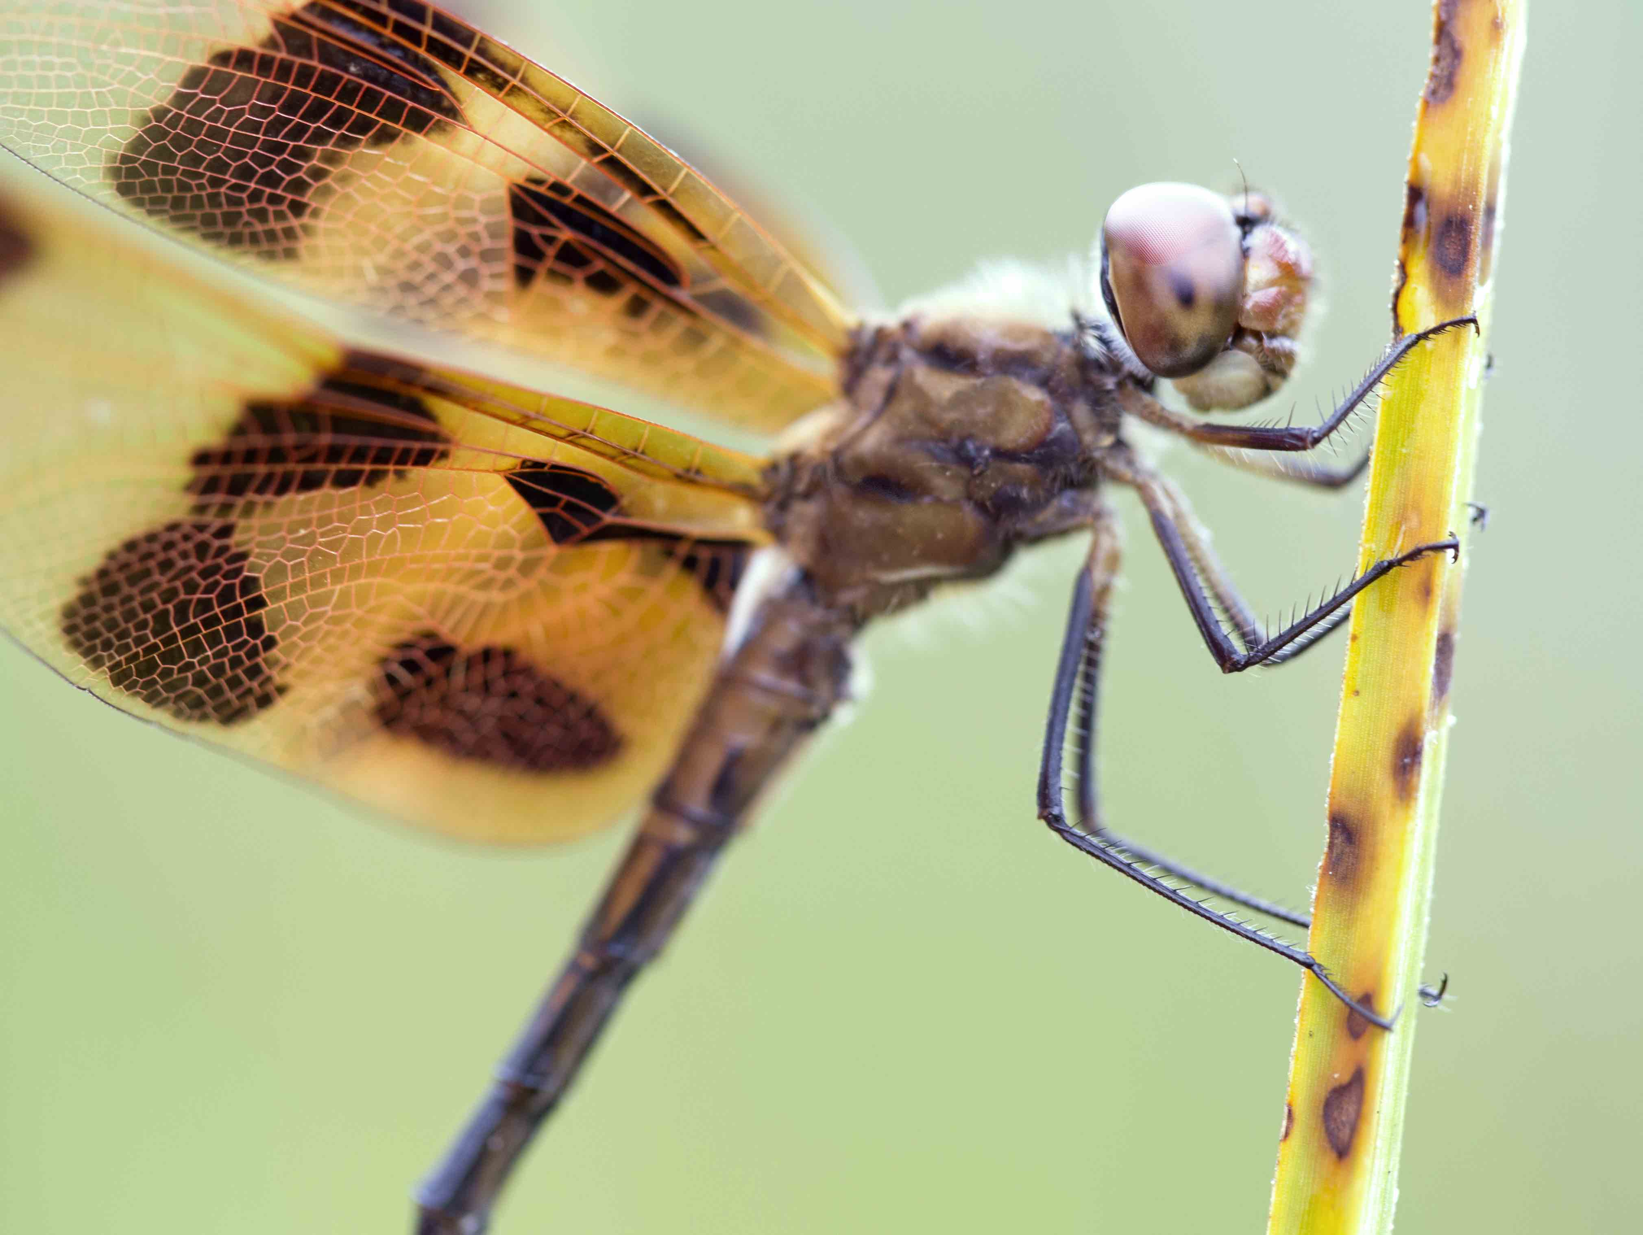
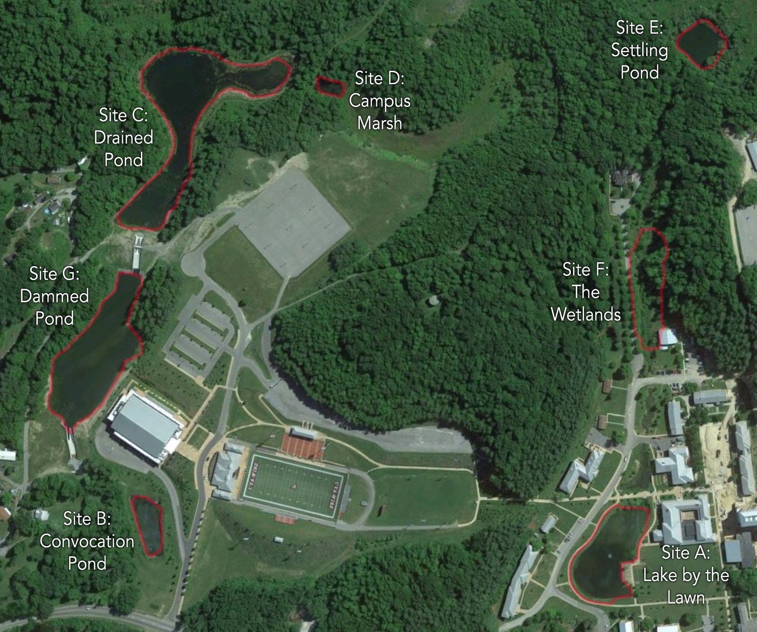

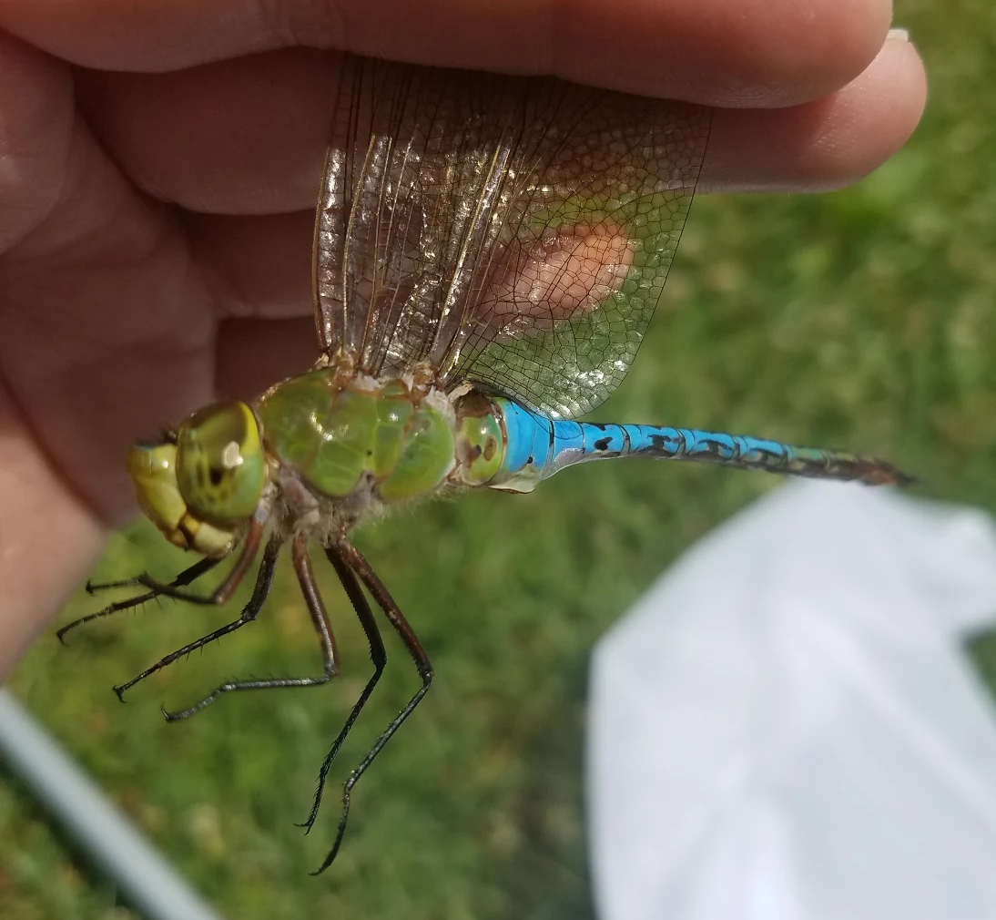
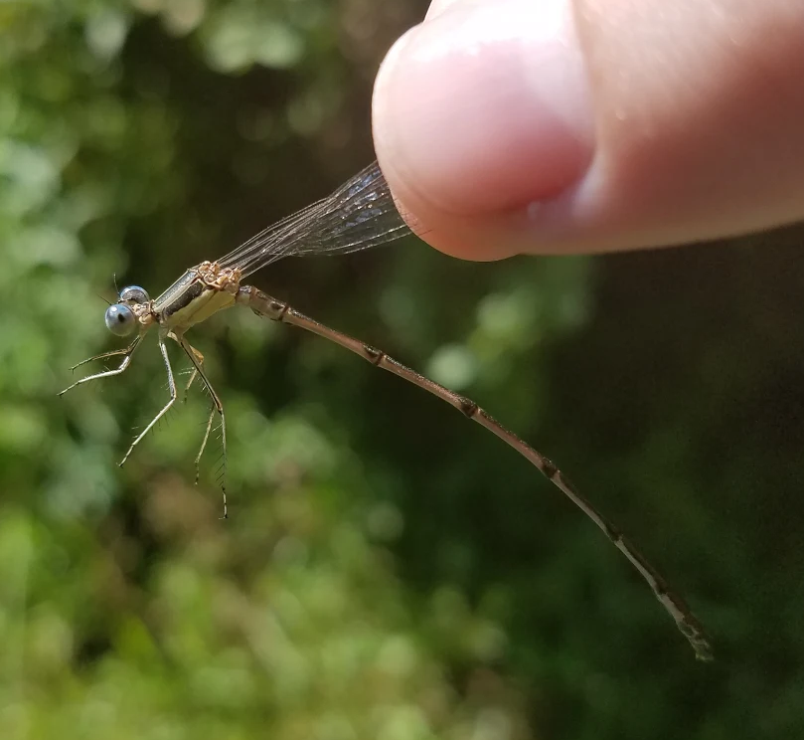
Phenological Shifts Detected for Zygoptera in the
Context of an Ongoing Inventory of Odonata
Christian Bullion, Malcolm Huguenin, James Vance, and Josephine Rodriguez
Department of Natural Sciences, The University of Virginia’s College at Wise, Wise, VA 24293
.
Abstract
Materials and Methods
Species | Suborder | 2015 DoY | 2017 DoY | Δ
Celithemis elisa | Anisoptera | 159 | 159 | 0
Arigomphus villosipes | Anisoptera | 160 | 171 | 11
Chromagrion conditum | Zygoptera | 160 | 160 | 0
Erythemis simplicicollis | Anisoptera | 160 | 163 | 3
Libellula cyanea | Anisoptera | 160 | 171 | 11
Libellula luctuosa | Anisoptera | 160 | 159 | -1
Pachydiplax longipennis | Anisoptera | 160 | 164 | 4
Argia fumipennis | Zygoptera | 161 | 163 | 2
Lestes eurinus | Zygoptera | 161 | 166 | 5
Libellula incesta | Anisoptera | 161 | 164 | 3
Plathemis lydia | Anisoptera | 161 | 158 | -3
Perithemis tenera | Zygoptera | 162 | 166 | 4
Enallagma aspersum | Zygoptera | 163 | 163 | 0
Tramea carolina | Anisoptera | 163 | 166 | 3
Anax longipes | Anisoptera | 167 | 173 | 6
Enallagma civile | Zygoptera | 167 | 160 | -7
Gomphus exilis | Anisoptera | 168 | 164 | -4
Ischnura verticalis | Zygoptera | 169 | 167 | -2
Ischnura posita | Zygoptera | 174 | 159 | -15
Calopteryx maculata | Zygoptera | 175 | 158 | -17
Enallagma basidens | Zygoptera | 175 | 167 | -8
Lestes vigilax | Zygoptera | 187 | 159 | -28
Tramea lacerata | Anisoptera | 187 | 164 | -23
Anax junius | Anisoptera | 195 | 187 | -8
The influence of climate change on phenology for Odonata has been well documented, showing a negative correlation between emergence date and temperature; spring-emerging species, with an overwintering diapause, are more susceptible to climate change than species emerging later in the summer. The context of this study is a biodiversity inventory of Odonata on the campus of UVa-Wise in Wise, VA that began in 2015. Odonates collected in Spring 2015 experienced a much colder winter than the specimens collected in 2017, which allowed for the testing of links between any earlier emergences and warmer temperatures. If winter temperatures increased, then it would be expected that adult odonate emergences will occur earlier in the year. First capture dates, which served as a proxy for emergence, for 24 species of spring-emerging odonates in 2017 were significantly earlier than their respective 2015 dates (p=.036) for only damselflies. This link observed here between temperatures and earlier emergences for damselflies, but not with dragonflies, is consistent with other research linking the effects of climate to larger-scale patterns in damselflies.
Sampling - In accordance with the 2015 biodiversity survey procedure, collection occurred alongside the six man-made bodies of water. Sampling procedures followed the collecting pattern established during the 2015 study. Sites were visited at approximately the same time daily, such that each site was visited on the same day during a weekly rotation. Equal time, adjusted isometrically for the number of people, was spent at each locale, to ensure that overall effort (measured in person-hours) remained consistent with reported 2015 sampling efforts.
Introduction
The order Odonata, which contains the suborders Anisoptera (dragonflies) and Zygoptera (damselflies), is a group of carnivorous insects that spend their immature stages as naiads in aquatic ecosystems (Triplehorn & Johnson, 2005). Odonata likely originated in tropical regions and uses diapause (an inactive resting stage) as a strategy to withstand cold winters in temperate regions (Pritchard & Leggott, 1987; Hassall & Thompson, 2008).
Figure 2: Sample sites on the UVa-Wise campus
Figure 3: Site C, the Drained Pond
Table 1. Changes in emergence dates from 2015 to 2017 for local odonates. DoY = day of year.
Emergence Dates and Sampling Protocols for the Inventory - Captured individuals were then preserved in a voucher system that, in continuation of the 2015 inventory, pairs an individual with a card bearing information relevant for long-term storage. This information, containing the species identification, date caught, and site designation, was logged into an Excel datasheet, along with observations for duplicates of abundant species for future use. As technical limitations prevented the direct observation of the naiad emergence, the first catch date served as a direct proxy for this emergence date for the purpose of statistical analysis.
Statistical Analysis - The date of first catch for every species recollected from the 2015 study was converted into a numerical day of year (DoY). This number served as a numerical proxy for the emergence date, allowing for statistical analysis using a pairwise t-test in Excel. As preliminary analysis revealed that Anisoptera and Zygoptera had noticeably different DoYs, statistical analysis was conducted to test for differences between the first catch date of 2015 and 2017 for each suborder separately. As warmer weather has been linked to earlier emergence times, these comparisons were made using a one-tailed testing model (Hassall, 2015). To account for the errors introduced by multiple testing, the p-values were adjusted in accordance with the False Discovery Rate method (Benjamini & Hochberg, 1995), using the p.adjust function (R Core Team, 2015).
Discussion
Statistical analysis revealed a significant difference in the response between the individual suborders. While the exact cause of this discrepancy remains unclear, the observed heightened responsiveness to overwintering temperatures displayed by the members of the suborder Zygoptera could potentially be caused by differences in physiology and behavior. Members of Zygoptera are known to be poor fliers, especially in comparison to the strong, migratory fliers found in suborder Anisoptera (Sánchez-Herrera & Ware, 2012). A study of biogeographic patterns in Odonata revealed that climate was a stronger contributor to distribution patterns in the Zygoptera, but not the Anisoptera (Heiser & Schmitt, 2010). While the shifts observed in this suborder are in response to extreme fluctuations in local weather over a short timespan, these differences are consistent with long-term studies of phenological trends in Odonata (Hassall et al., 2007).
Members of suborder Anisoptera are traditionally stronger fliers capable of migratory flights, and could instead be responding to warming overwintering conditions by displaying changes in migratory behavior. Future studies could address the hypothesis that the seemingly increased phenological responsiveness for the damselflies is potentially advantageous in competing against the stronger flying dragonflies, and that these earlier emergences can “compensate” for poorer dispersal and flying abilities in their environments.
Figure 1.1: Anax junius, a dragonfly (Anisoptera)
Figure 1.2: Lestes vigilax, a damselfly (Zygoptera)
In response to long-term increases in temperature, Odonata have responded over time with advances in phenology, the timing of crucial biological events (Hassall et al., 2007). It has been hypothesized that the developmental rates of Odonata would increase as the environmental temperatures rose, resulting in the advancement of their flight period. It can be expected that a drastic increase in local overwintering temperatures, even over a short time frame, could impact local Odonata phenology. Analyzing inventory data for these two years allowed for the testing of the hypothesis that, if subjected to warmer overwintering temperatures, then locally occurring species of Odonata can be expected to emerge earlier than species that endured a colder winter season. A short-term dataset on the UVa-Wise campus was established during a 2015 biodiversity study of Odonata (Marshall & Rodriguez, unpublished data), and continuation of this inventory in 2017 allows for the asking of questions regarding Odonata and temporal events (ex: phenology).
Local Overwintering Temperatures - Comparisons between the average monthly temperatures from the NOAA weather archives for the three winter months of December, January, and February in Wise County revealed a large shift in temperature trends between 2015 and 2017 (NWS Internet Services Team, n.d.). While December temperatures remained fairly constant, with only a 2.9 °F (1.61°C) difference between the two years, January and February show a growing difference in monthly averages. The average January temperatures in 2017 were 7.4°F (4.11°C) warmer than the equivalent 2015 averages, while the average February temperatures in 2017 were 16.5°F (9.16°C) warmer than in 2015. This demonstrates that the overwintering conditions for 2017, especially late in the winter season, were remarkably warmer than the 2015 season.
Results
From the 36 species caught in 2015, 24 recollected species met the criteria of being a spring-emerging species. Closer analysis between the responsiveness of the suborders Anisoptera and Zygoptera revealed mixed results. Members of the suborder Zygoptera were more phenologically responsive than Anisoptera, and displayed first capture dates significantly earlier in 2017 than in 2015 (p=.018, FDR adjusted p-value =.036), with the mean first capture date for Zygoptera advancing approximately one week. However, members of the suborder Anisoptera showed a nonsignificant forward shift (p=.453, FDR adjusted p-value =.453) corresponding with a mean first capture date that only advanced roughly 0.43 days.
A majority of odonates showing large shifts belonged to the suborder Zygoptera, the damselflies, with many members of this suborder displaying large shifts of greater than two weeks. For example, Lestes vigilax was caught 28 days earlier in 2017 than in the cooler 2015. The single highly shifted Anisoptera, Tramea lacerata, is likely an outlier resulting from behavioral differences in dragonfly species.
References
Benjamini, Y., and Hochberg, Y. (1995). Controlling the false discovery rate: A practical and powerful approach to multiple testing. Journal of the Royal
Statistical Society Series B 57, 289–300.
Hassall, C. & Thompson, D. J. (2008). The impacts of environmental warming on Odonata: A review. International Journal of Odonatology 11(2): 131-153.
Hassall, C., Thompson, D. J., French, G. C. & Harvey, I. F. (2007). Historical changes in the phenology of British Odonata are related to climate.
Global Change Biology 13: 933–941. doi: 10.1111/j.1365-2486.2007.01318.x
Hassall, C. (2015). Odonata as candidate macroecological barometers for global climate change. Freshwater Science 34 (3): 1040-1049.
doi: 10.1086/682210
NWS Internet Services Team. (n.d.). In National Oceanic and Atmospheric Administration Retrieved October 13, 2017 from http://w2.weather.gov/climate/
Pritchard, G. & M. Leggott. (1987). Temperature, incubation rates and the origins of dragonflies. Advances in Odonatology 3: 121-126.
R Core Team (2015). R: A language and environment for statistical computing. R Foundation for Statistical Computing, Vienna, Austria.
URL http://www.R-project.org/.
Triplehorn, C. A., Johnson, N. F., & Borror, D. J. (2005). Borror and DeLong’s Introduction to the Study of Insects (7th ed). Belmont, CA: Brooks/Cole.
Winder, M., & Schindler, D. E. (2004). Climate change un-couples trophic interactions in an aquatic ecosystem. Ecology 85: 2100–2106.
Acknowledgements
We would like to recognize the Department of Natural Sciences at UVa-Wise for the support of this project. A special thanks goes to Austin Marshall (UVa-Wise) for the use of the 2015 Odonata emergence dates used in this analysis. We also want to thank Dr. Liza Comita (Yale School of Forestry) for her help in running the p.adjust function in R.

